Slide 1
Toll Management System
Mock UI
Presented by : Md. Kamrujjaman (1705081)
Group - 02
1705072 - Sourov
1705079 - Shammo
1705080 - Shafayat
1705081 - Kamrul
1705082 - Mehedi
1705084 - Utsa

Slide 2
USER SECTION

Slide 3
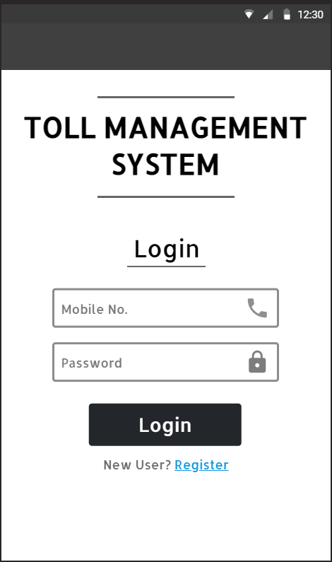
Login Page

Slide 4
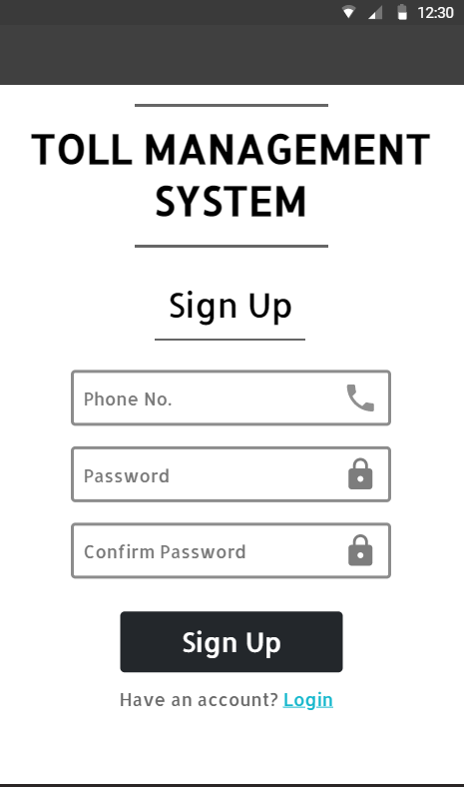
Signup Page

Slide 5
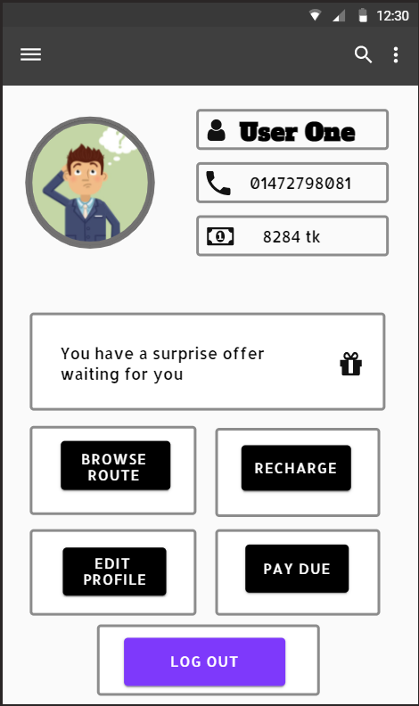
Home Page

Slide 6
Login Page

Slide 7
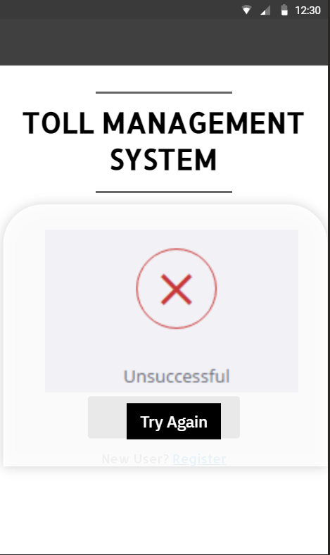
Login Failed

Slide 8
Login Page

Slide 9
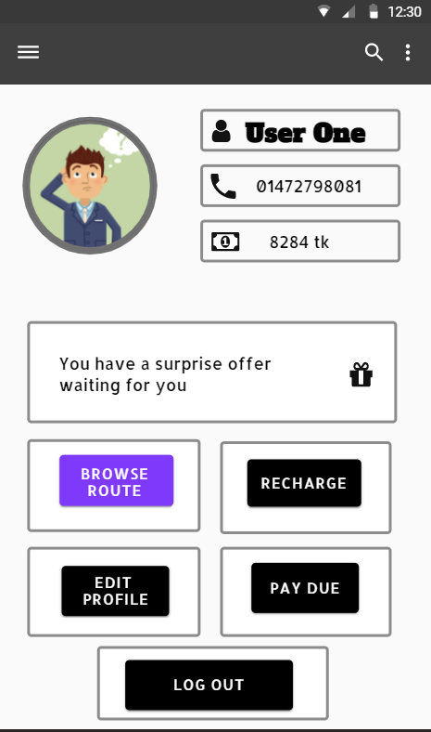
Home Page

Slide 10
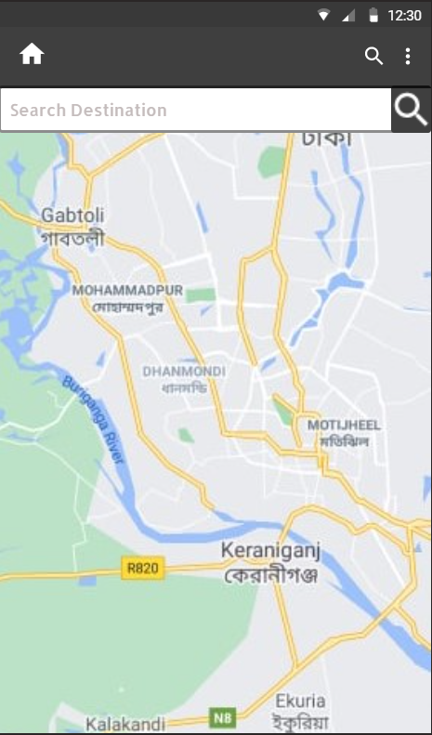
Browsing Route

Slide 11
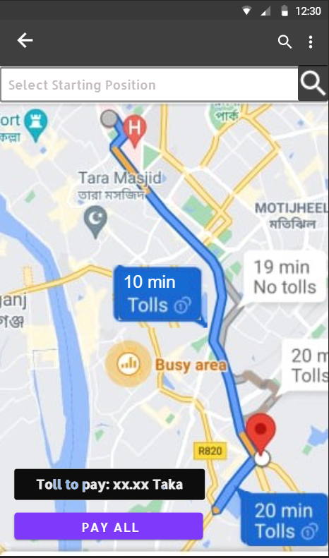
Search Destination

Slide 12
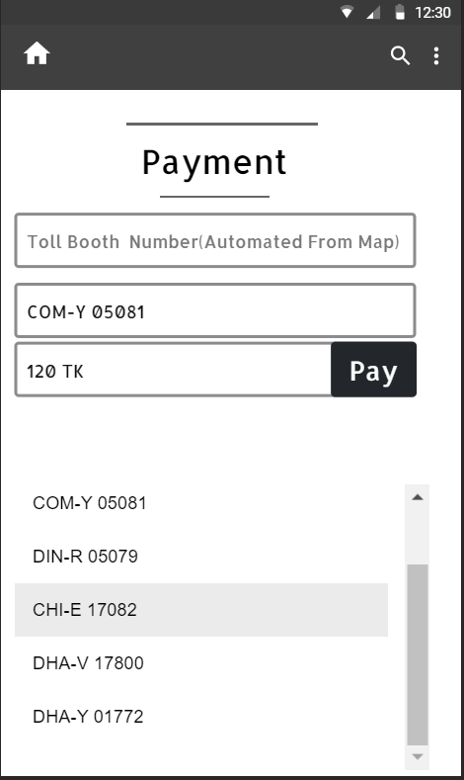
Pay All

Slide 13
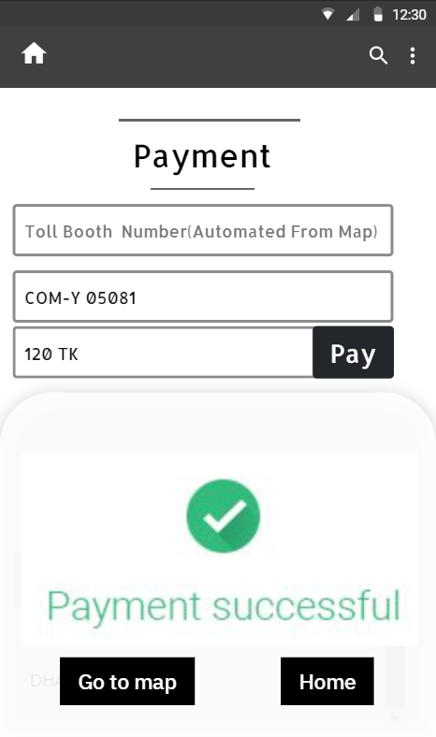
Payment Successful

Slide 14
Home Page

Slide 15
Browsing Route

Slide 16
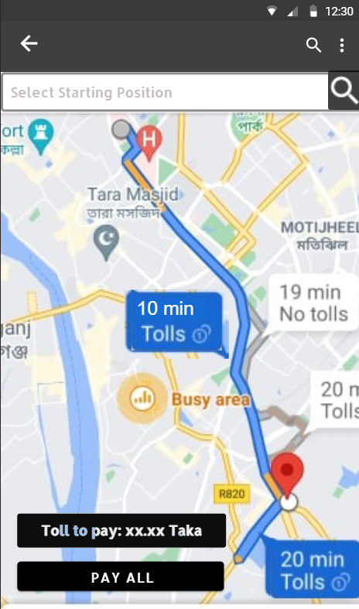
Search Destination

Slide 17
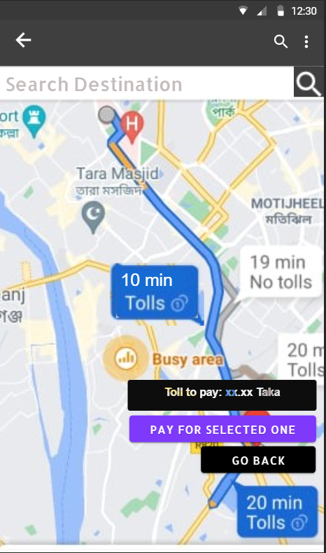
Selective Payment

Slide 18
Payment

Slide 19
Payment Successful

Slide 20

Search Destination

Slide 21
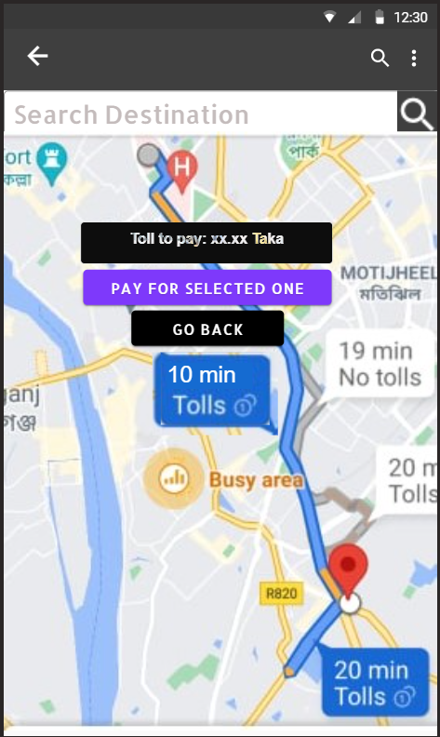
Another Selective Payment

Slide 22
Payment

Slide 23
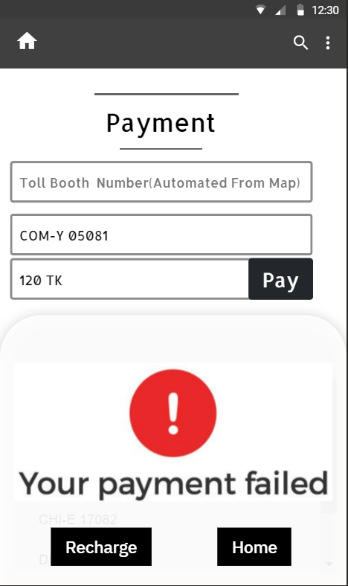
Payment Failed

Slide 24
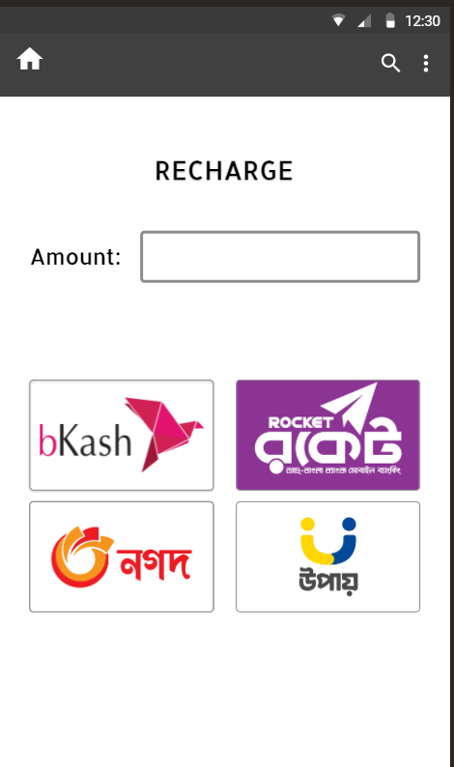
Recharge

Slide 25
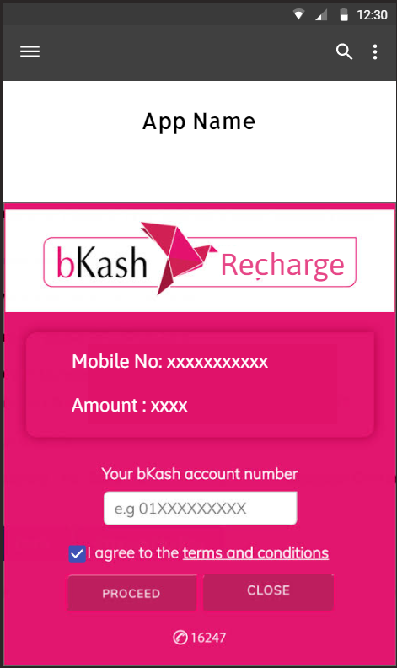
Recharge

Slide 26
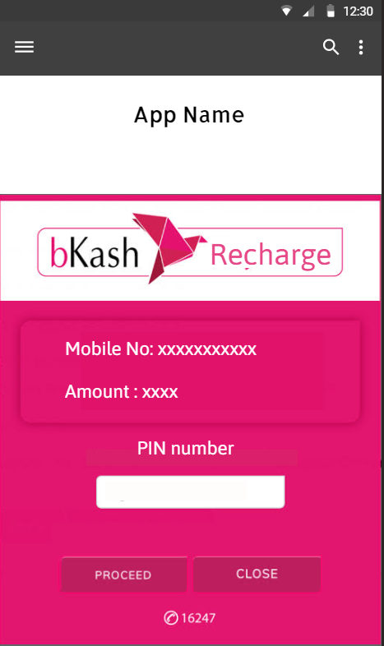
Recharge

Slide 27
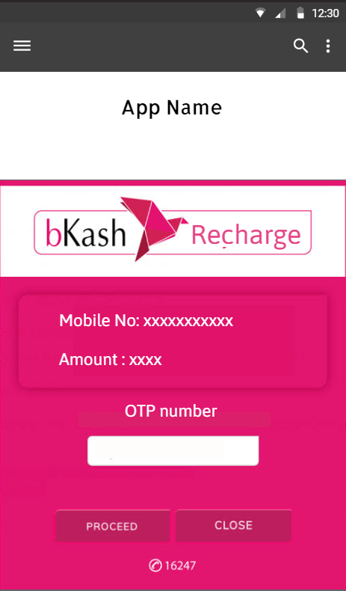
Recharge

Slide 28
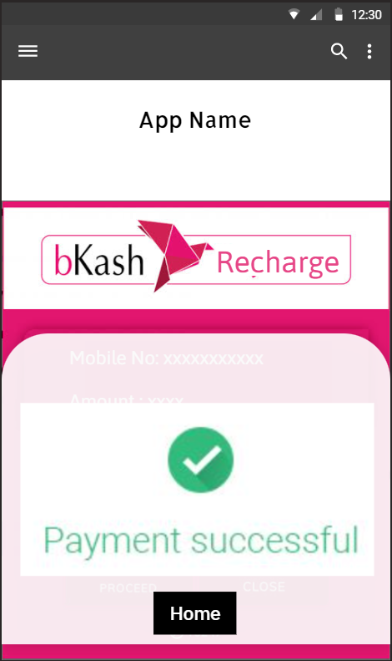
Recharge

Slide 29
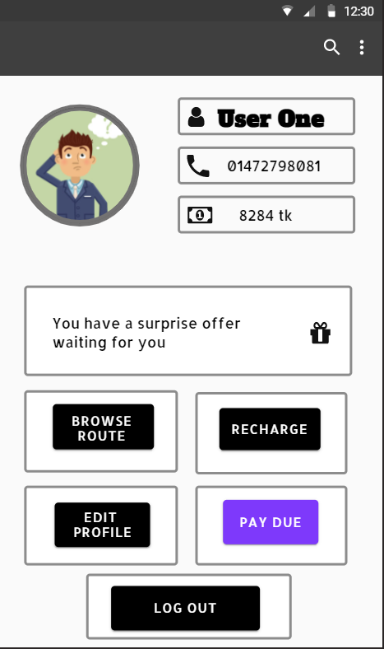
Home

Slide 30
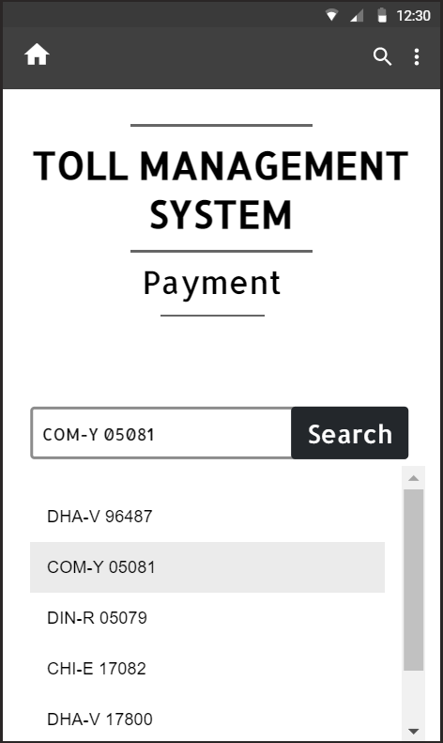
Due Payment

Slide 31
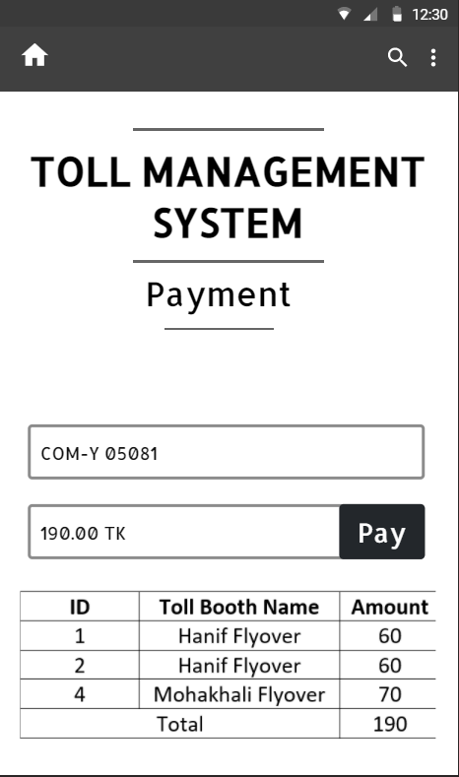
Due Payment

Slide 32
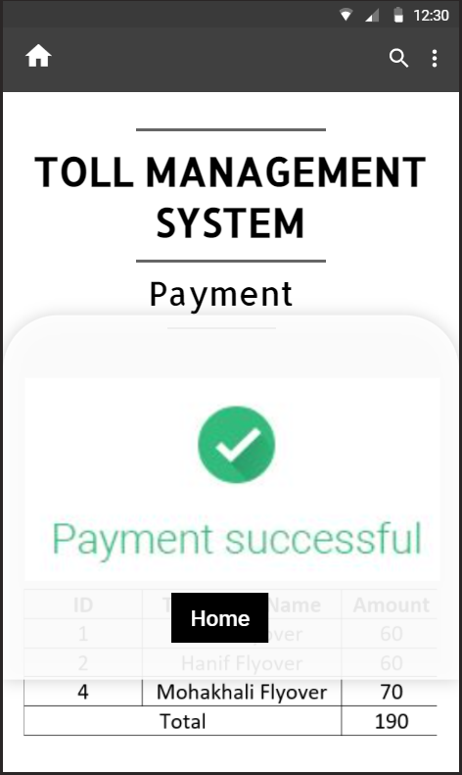
Payment Successful

Slide 33
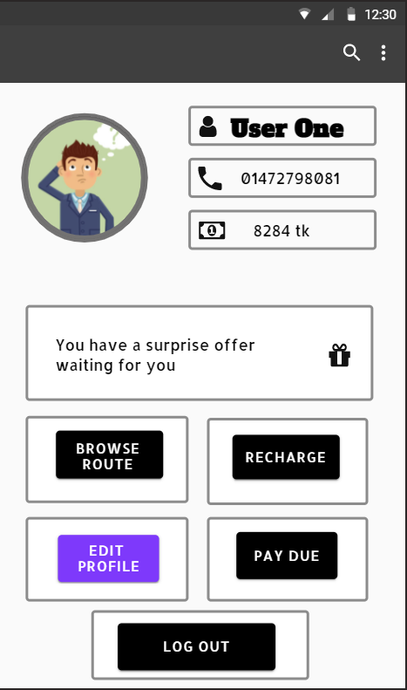
Home Page

Slide 34
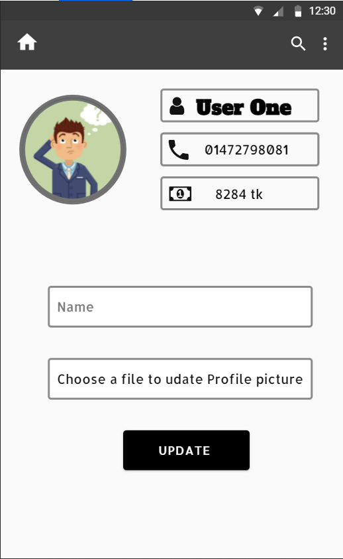
Home Page

Slide 35
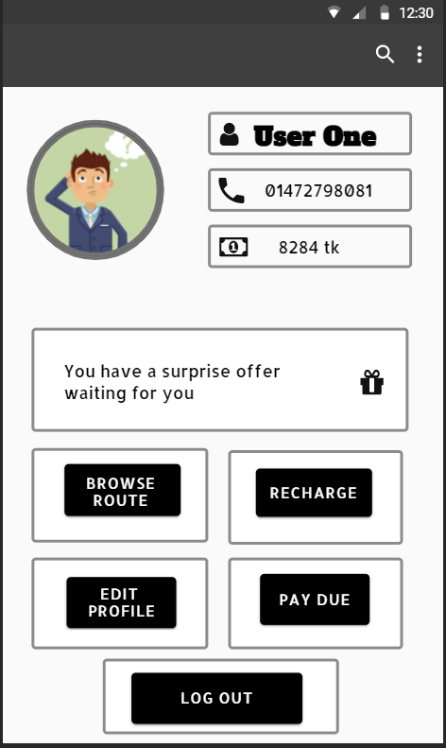
Home Page

Slide 36
ADMIN SECTION

Slide 37
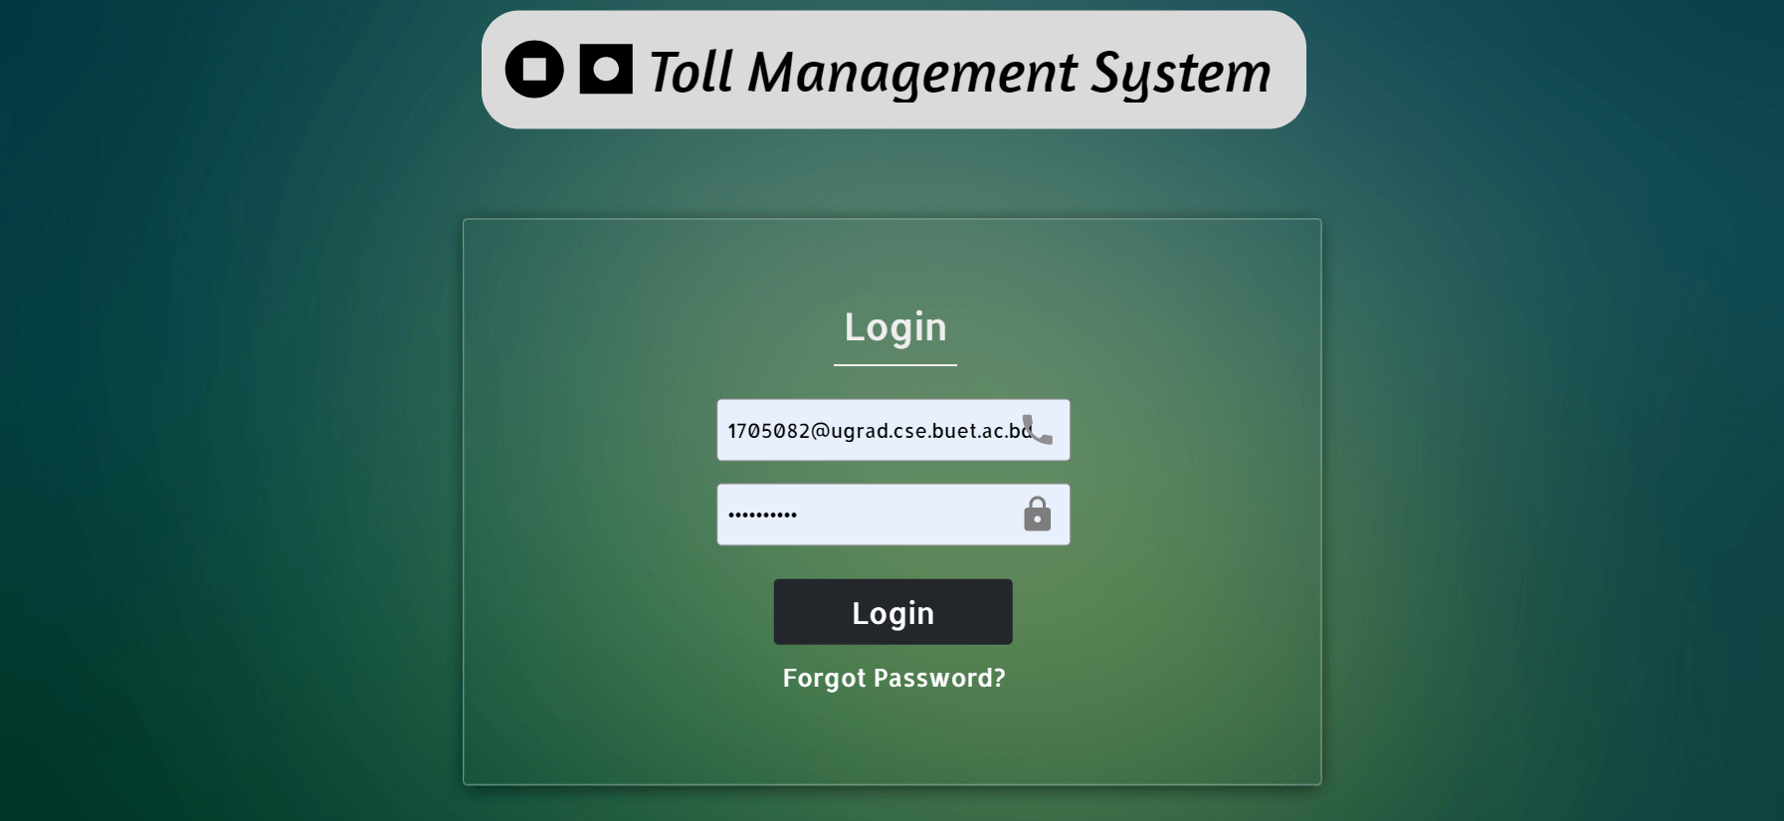

Slide 38
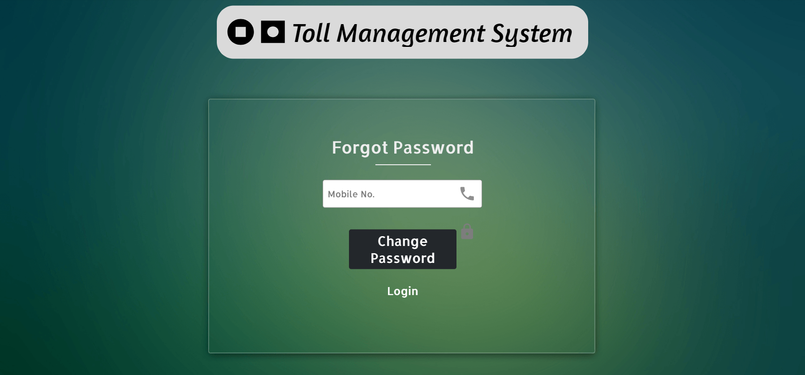

Slide 39
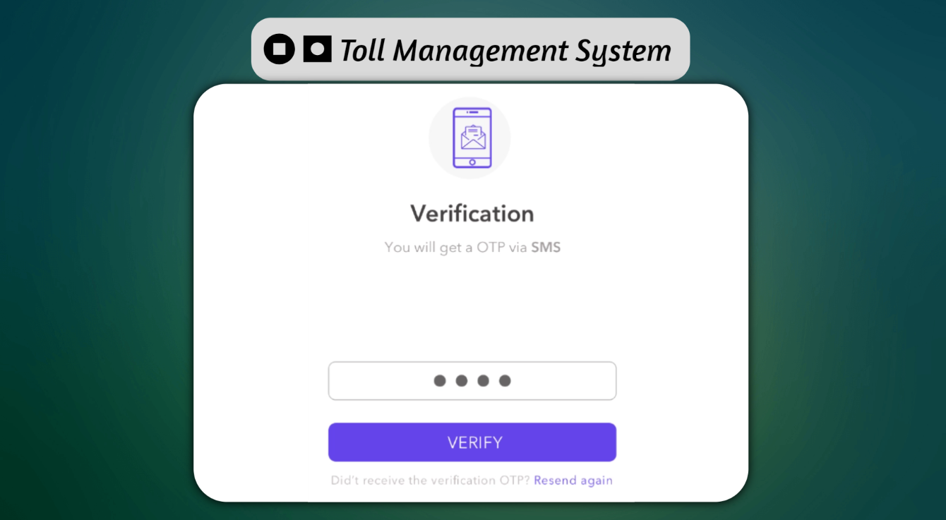

Slide 40
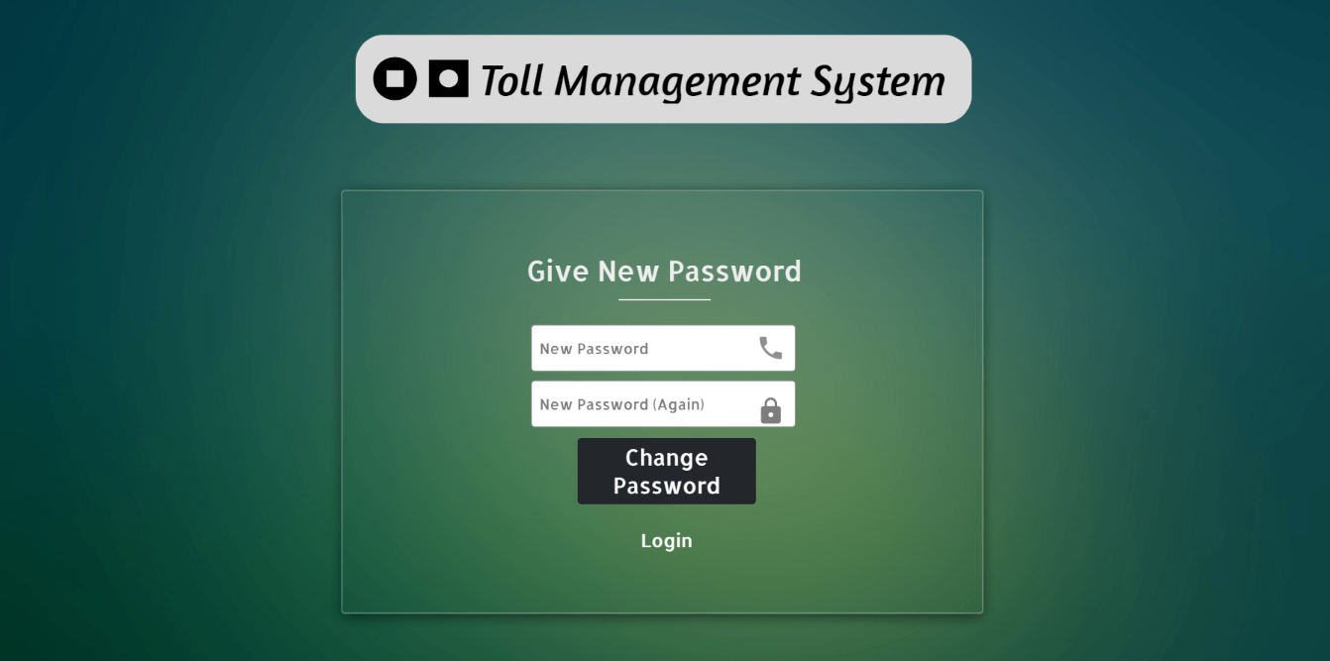

Slide 41
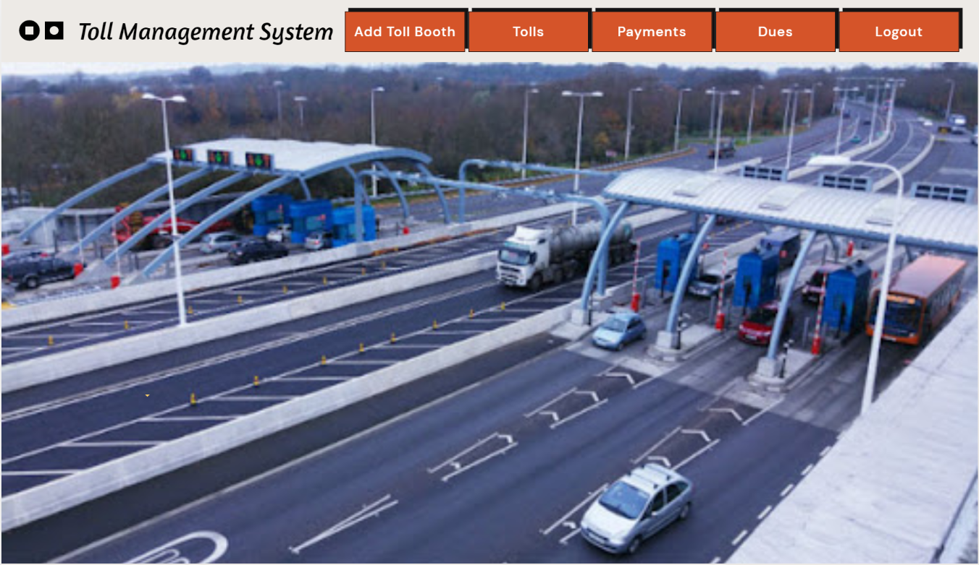

Slide 42
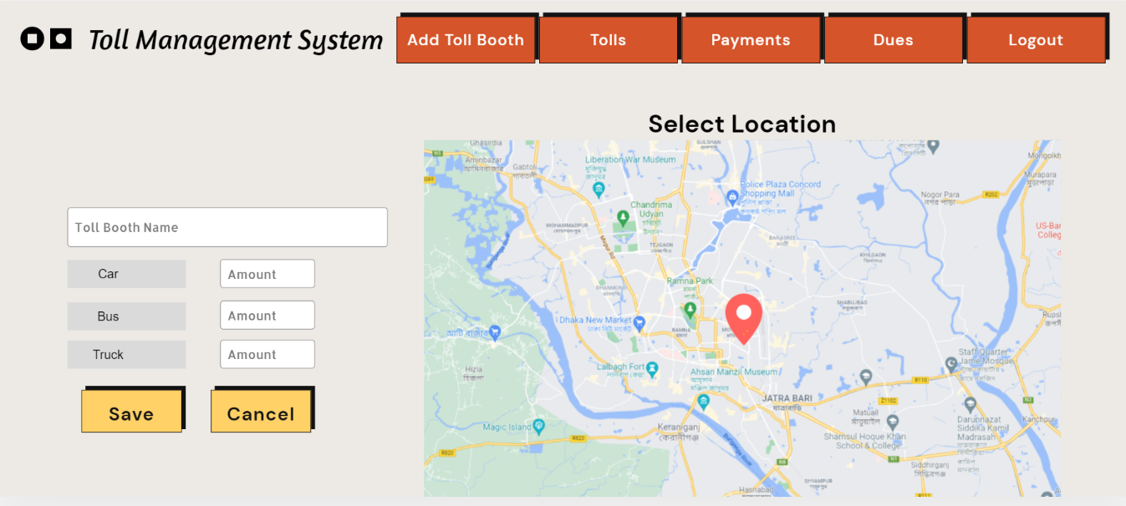

Slide 43
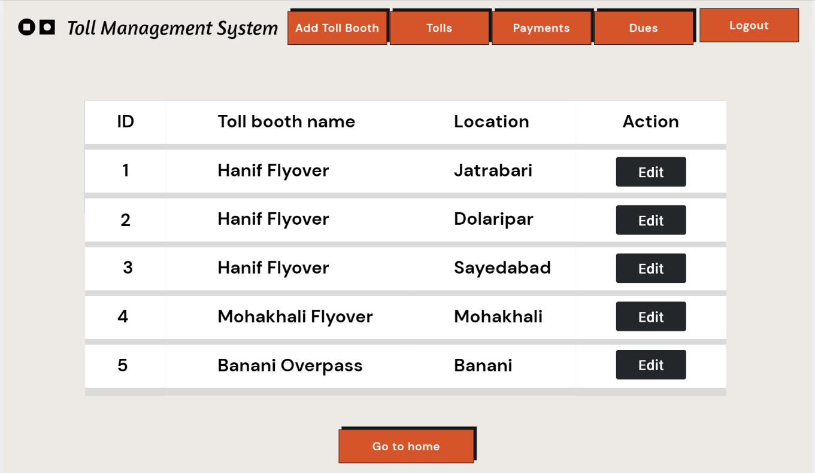

Slide 46
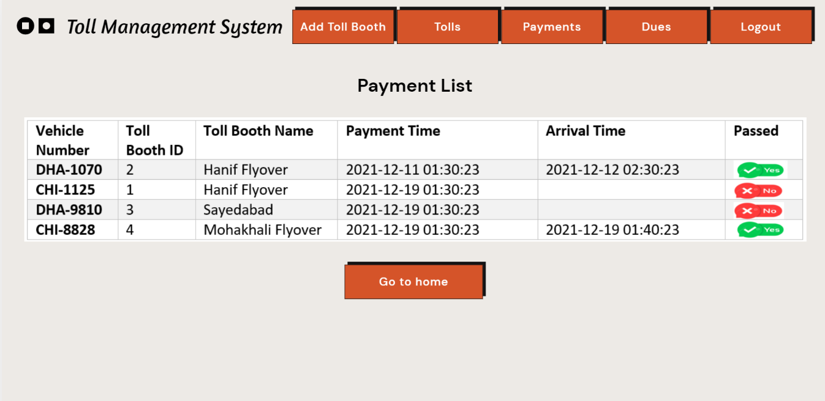

Slide 47
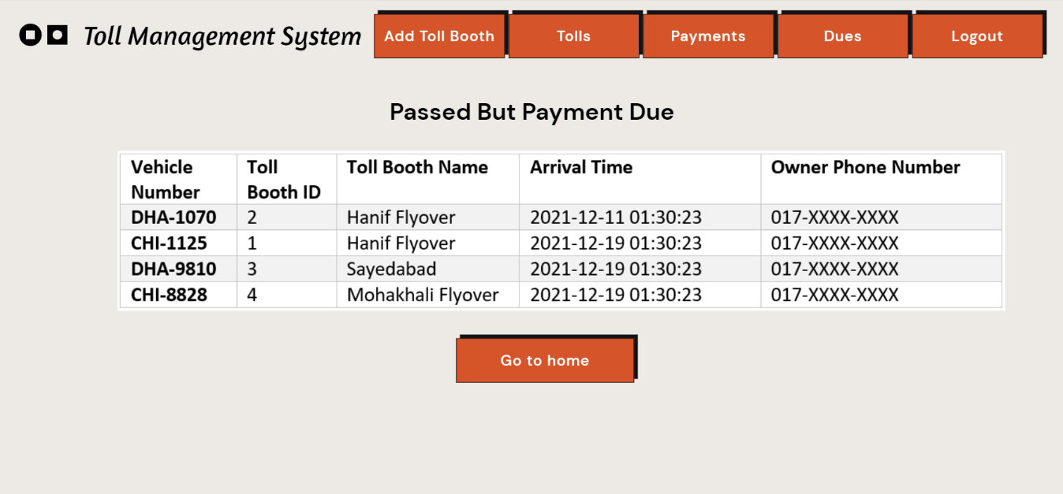

Slide 48


